Slide 1

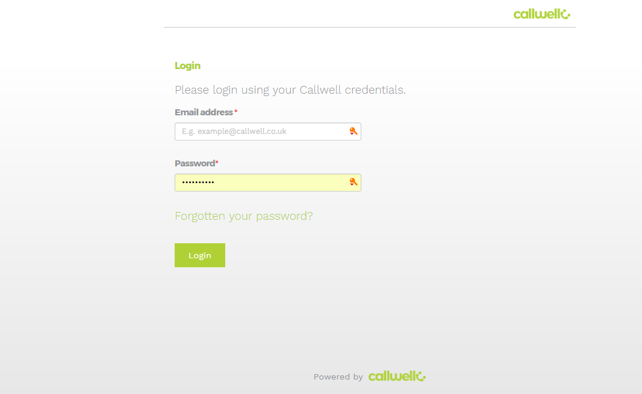

Forgotten your password ?
If you have forgotten your password, simply go to your Callwell log in page, enter your email address
Then click forgotten your password
You will then receive an email containing a link and instructions.
Once you have completed this you can then log into Callwell

